Slide 1


Vendor Performance & Sales Analysis

Slide 2


CONTENTS
1. Summary Report | Data from 6 CSV Files | Powered by Python & Power BI
2. Project Overview
3. Data Sources
4. Data Ingestion Process
5. Vendor Summary Computation
6. Key Metrics & KPIs
7. Business Insights & Observations
8. Recommendations
9. Power BI Dashboard Integration
10. Sales vs Purchases vs Freight (Top Vendors)
11. Profit Margin Distribution
12. Vendor & Product Description Counts
13. Feature Distribution Histograms

Slide 3


01
Summary Report | Data from 6 CSV Files | Powered by Python & Power BI

Slide 4

02
Project Overview

Slide 5


Project Overview
Purpose
Tools
Outcome
Evaluate vendor performance using sales, purchases, freight, and inventory data.
Python, SQLite, Power BI, Pandas, SQLAlchemy, pptx.
Cleaned dataset, computed KPIs, and interactive dashboard.

Slide 6

03
Data Sources

Slide 7

Data Sources
The analysis uses six CSV files:
begin_inventory.csv
end_inventory.csv
purchase_prices.csv
vendor_invoice.csv
purchases.csv
sales.csv

Slide 8

04
Data Ingestion Process

Slide 9


Data Ingestion Process
Script: Ingestion_db.py
Reads CSVs and loads into SQLite database.
Logs progress and timing to logs/ingestion_db.log.
Uses SQLAlchemy for table creation and replacement.

Slide 10

05
Vendor Summary Computation

Slide 11


Vendor Summary Computation
1
2
3
4
Script: get_vendor_summary.py
Combines Freight, Purchases, and Sales via SQL CTEs.
Aggregates metrics by VendorNumber and Brand.
Outputs detailed summary DataFrame.

Slide 12

06
Key Metrics & KPIs

Slide 13



Key Metrics & KPIs
Gross Profit = Sales Dollars – Purchase Dollars
Profit Margin (%) = (Gross Profit / Sales Dollars) × 100
Stock Turnover = Sales Quantity / Purchase Quantity
Sales-to-Purchase Ratio = Sales Dollars / Purchase Dollars
Freight Cost summarized per Vendor

Slide 14

07
Business Insights & Observations

Slide 15

Business Insights & Observations
High-performing vendors: High margins, efficient turnover, low freight ratio.
Underperformers flagged for review: Negative profits or excess stock.
Freight cost optimization is a key opportunity.

Slide 16

08
Recommendations

Slide 17


Recommendations
Renegotiate freight terms for high-cost vendors.
Adjust purchasing strategy to improve turnover.
Investigate price variances impacting margins.
Automate pipeline for regular reporting and dashboard refresh.

Slide 18

09
Power BI Dashboard Integration

Slide 19




Power BI Dashboard Integration
Dashboard File: Vendor Sales Dashboard.pbix
Visuals: Sales vs Purchases, Margins, Vendor Comparison.
1
2
4
3
Enables interactive analysis for stakeholders.
Publish to Power BI Service for live data updates.

Slide 20

10
Sales vs Purchases vs Freight (Top Vendors)

Slide 21

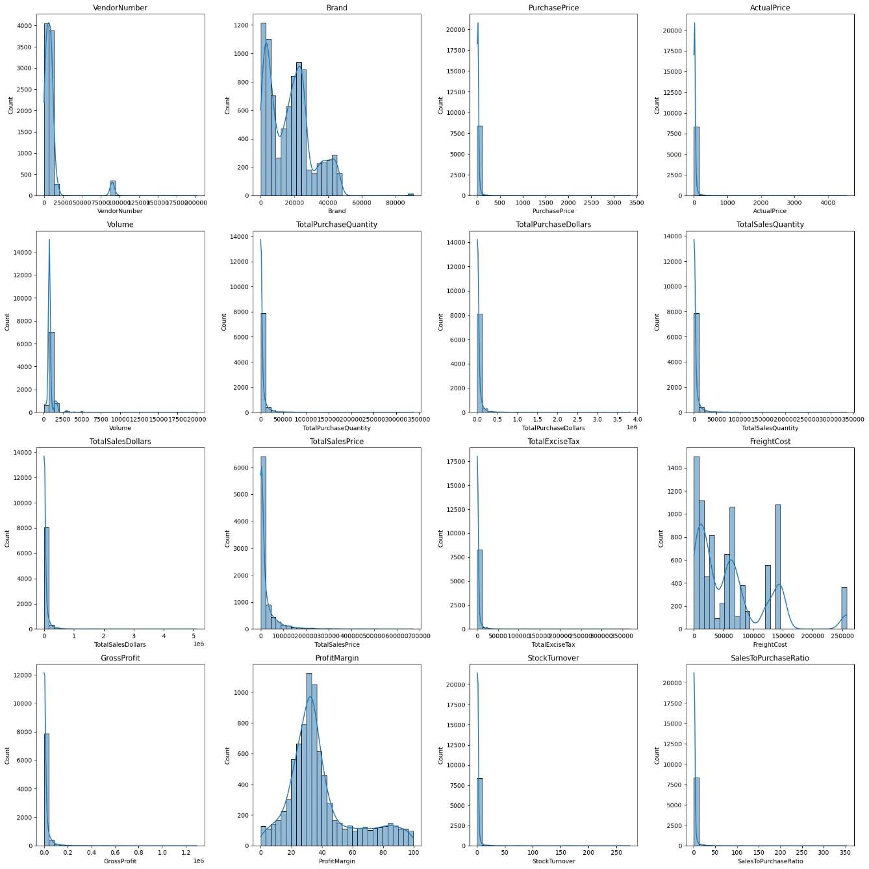
Sales vs Purchases vs Freight (Top Vendors)

Slide 22

11
Profit Margin Distribution

Slide 23
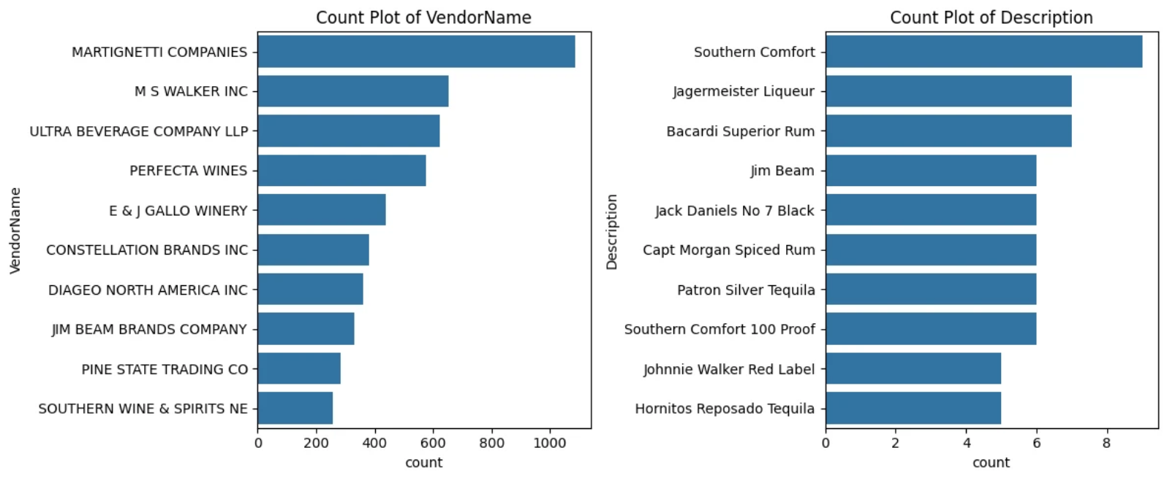
Profit Margin Distribution

Slide 24

12
Vendor & Product Description Counts

Slide 25


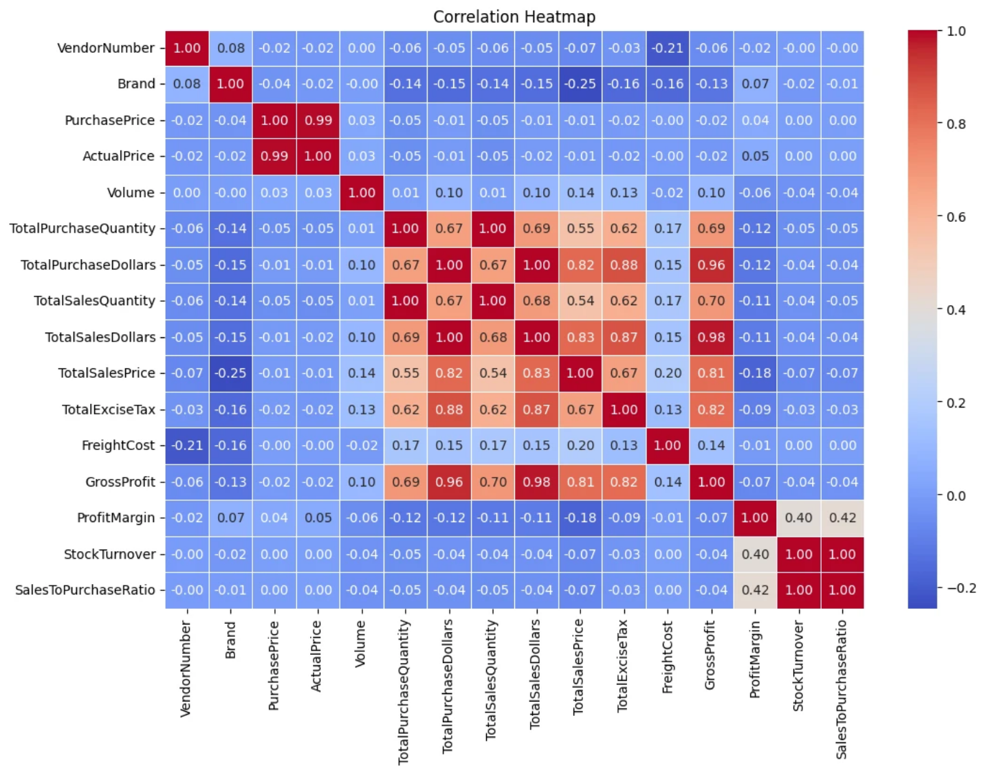
Vendor & Product Description Counts

Slide 26

13
Feature Distribution Histograms

Slide 27
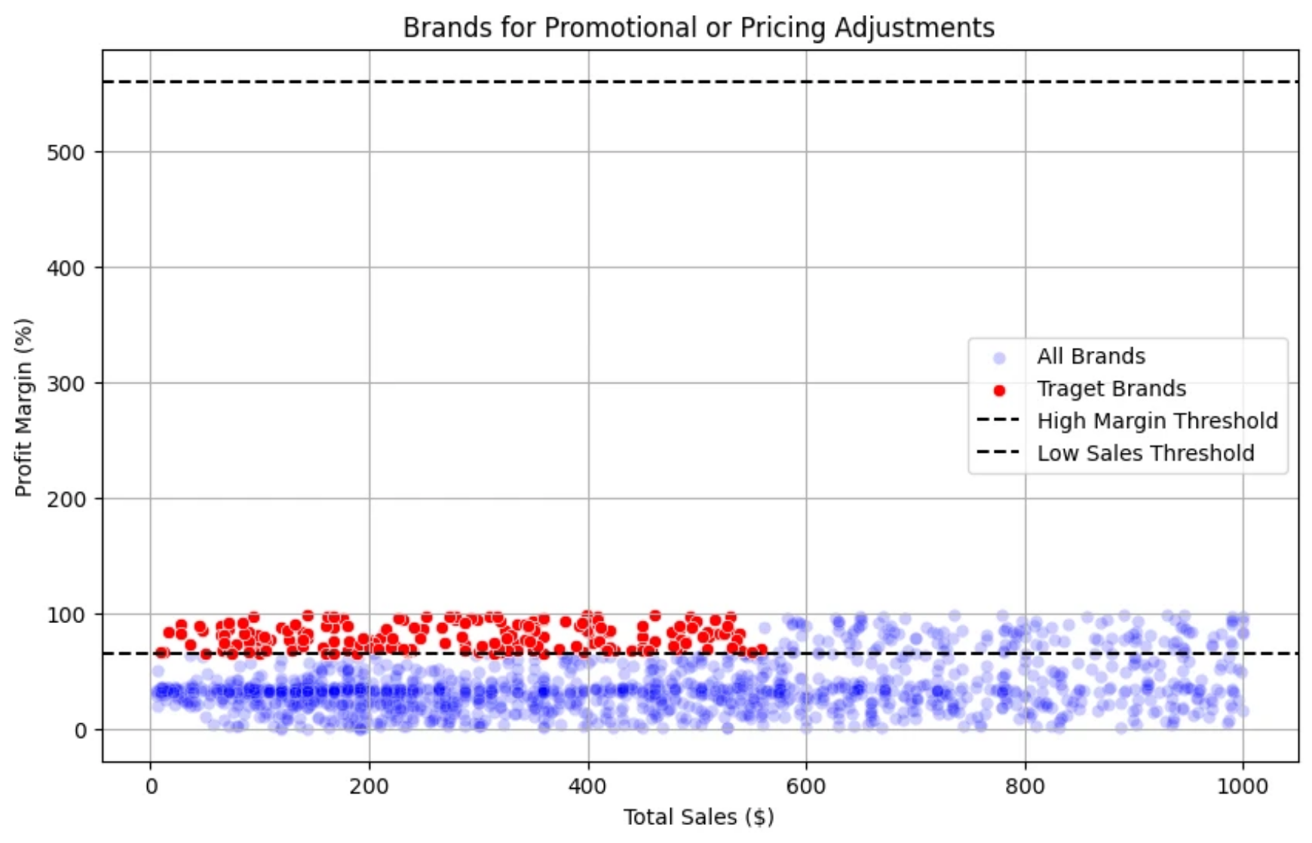
Feature Distribution Histograms

Slide 28

Thank You

